Slide 1


< How Hackers find your Location from an IP Address | Cybersecurity Demo> Created By:

Slide 2

DISCLAIMER
This software/project is provided "AS IS" without any warranties of any kind, either express or implied, including but not limited to the implied warranties of merchantability, fitness for a particular purpose, or non-infringement.
The authors and contributors are not responsible for any damages, data loss, or other consequences arising from the use or misuse of this software/project.
By using this software/project, you agree that you are solely responsible for compliance with all applicable laws and regulations in your jurisdiction.
If you are using this software/project for penetration testing, cybersecurity research, or any other activity that interacts with systems you do not own, you must obtain explicit permission from the system owner. Unauthorized use may violate local, state, and federal laws.

Slide 3
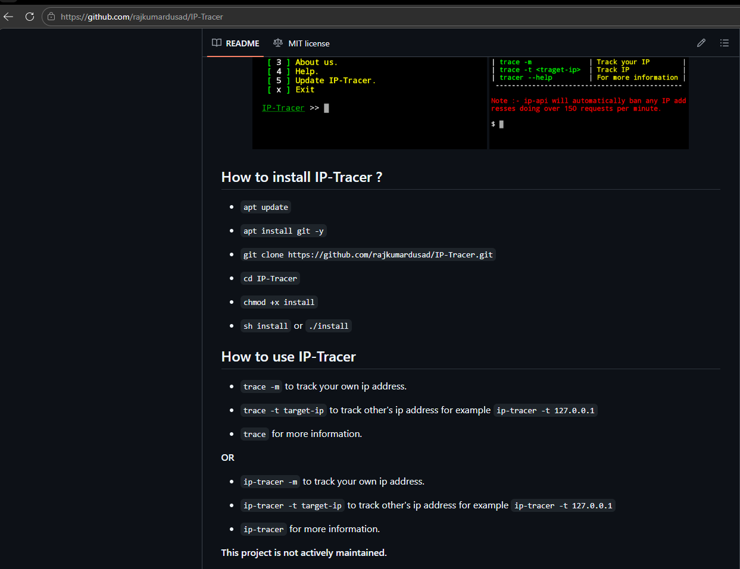
1st step – go to https://github.com/rajkumardusad/IP-Tracer

Slide 4
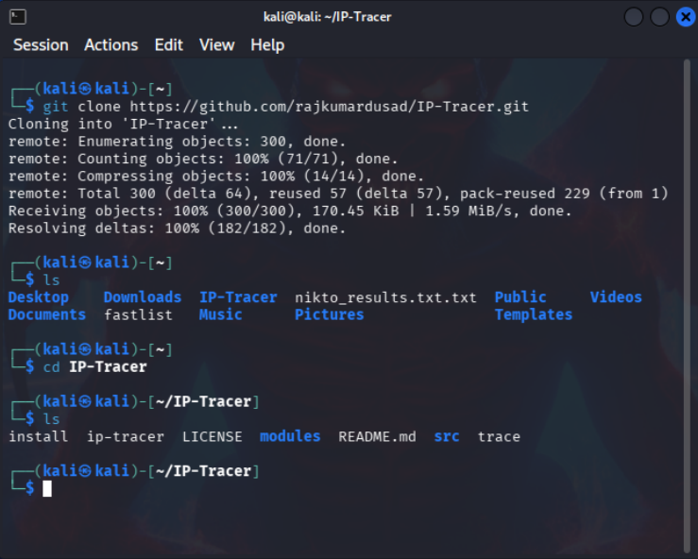
2nd Step: <Copy & Paste>: git clone https://github.com/rajkumardusad/IP-Tracer.git at the Kali Linux prompt.

Slide 5
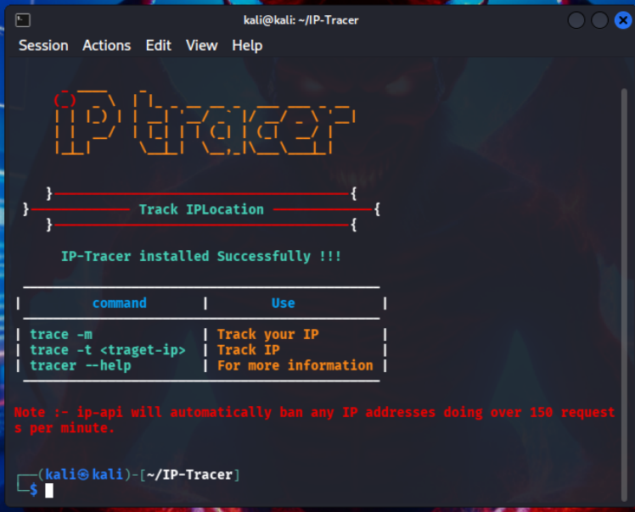
3. Copy and paste the following: chmod +x install & sh install or ./install. Then the following screen will appear:

Slide 6
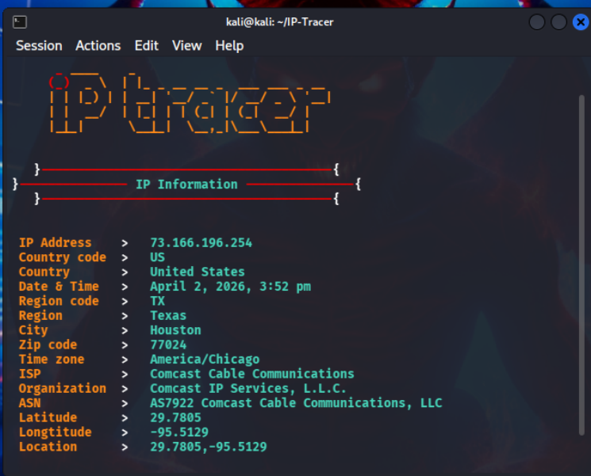
Type the command – trace –m 192.168.32.1 and the results will be displayed:

Slide 7
📒Summary of Commands Used for this Exercise:
1. Clone the repository here - https://github.com/rajkumardusad/IP-Tracer. 🌐
2. <Copy & Paste>: git clone https://github.com/rajkumardusad/IP-Tracer.git at the Kali Linux prompt.
3. <Copy & Paste>: cd IP-Tracer - [to change to the IP-Tracer directory].
4. Type #ls to see the main script file - [ip-tracer].
5. <Copy & Paste>: chmod +x install.
6. <Copy & Paste>: sh install or ./install.
7. Launch the tool by typing IP-tracer.
8. Type - trace -t < IP address>.
9. Seconds later, information is displayed about the IP address.

